Slide 1
Project name
Face Recognition
-Juma Sinare
-Prashant Bhandari
-Vishal Thapa

Slide 2
Outline
Introduction
History
Facial Recognition
Technology Used
Applications
Conclusion
References

Slide 3
INTRODUCTION
Everyday actions are increasingly being handled electronically, instead of pencil and paper or face to face.
This growth in electronic transactions results in great demand for fast and accurate user identification and authentication.

Slide 4
Contd…
Access codes for buildings, banks accounts and computer systems often use PIN's for identification and security clearances
Using the proper PIN gains access, but the user of the PIN is not verified. When credit and ATM cards are lost or stolen, an unauthorized user can often come up with the correct personal codes.

Slide 5
Facial Recognition ???
It requires no physical interaction on behalf of the user.
It is accurate and allows for high enrolment and verification rates.
It can use your existing hardware infrastructure, existing camaras and image capture Devices will work with no problems

Slide 6
History
In 1960s, the first semi-automated system for facial recognition to locate the features(such as eyes, ears, nose and mouth) on the photographs.
In 1970s, Goldstein and Harmon used 21 specific subjective markers such as hair color and lip thickness to automate the recognition.
In 1988, Kirby and Sirovich used standard linear algebra technique, to the face recognition.

Slide 7
Facial Recognition
In Facial recognition there are two types of comparisons:-
VERIFICATION- The system compares the given individual with who they say they are and gives a yes or no decision.
IDENTIFICATION- The system compares the given individual to all the Other individuals in the database and gives a ranked list of matches.

Slide 8
Contd…
All identification or authentication technologies operate using the following four stages:
Capture: A physical or behavioural sample is captured by the system during Enrollment and also in identification or verification process.
Extraction: unique data is extracted from the sample and a template is created.
Comparison: the template is then compared with a new sample.
Match/non-match: the system decides if the features extracted from the new Samples are a match or a non match.

Slide 9
Technology used
Open cv 2.0
face_recognition
Python
Numpy lib
Primary camera

Slide 10
The Open cv Technology
OpenCV (Open Source Computer Vision) is a library of programming functions mainly aimed at real-time computer vision. Originally developed by Intel. The library is cross-platform and free for use under the open-source BSD license.
OpenCV supports the deep learning frameworks TensorFlow, Torch/PyTorch and Caffe.

Slide 11
The Python Language
Python is a general-purpose interpreted, interactive, object-oriented, and high-level programming language.
It was created by Guido van Rossum during 1985- 1990.
Python source code is also available under the GNU General Public License (GPL).

Slide 12
The Numpy lib
NumPy is the fundamental package for scientific computing with Python. It contains among other things: a powerful N-dimensional array object.

Slide 13
The primary camera
It is a video camera that feeds or streams its image in real time to or through a computer to a computer network. When "captured" by the computer.

Slide 14
Main idea to solve the problem
Using machine learning
Haarcascade algorithm
Haarcascade_frontalface_default.xml used

Slide 15
Machine learning
Machine learning is the science of getting computers to act without being explicitly programmed.
In the past decade, machine learning has given us self driving cars, practical speech recognition, effective web search, and a vastly improved understanding of the human genome.

Slide 16
Haarcascade method
It is an algorithm used in Object Detection using Haar feature-based cascade classifiers is an effective object detection method proposed by Paul Viola and Michael Jones in their paper.
It is a machine learning based approach where a cascade function is trained from a lot of positive and negative images. It is then used to detect objects in other images.

Slide 17
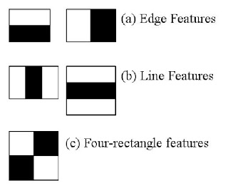
Haarcascade pixel subtraction features

Slide 18
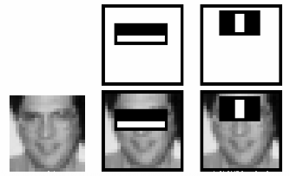
Haarcascsde pixel subtraction for face detection

Slide 19
_frontalface_default.xml
A Haar Cascade is basically a classifier which is used to detect particular objects from the source.
The haarcascade_frontalface_default.xml is a haar cascade designed by OpenCV to detect the frontal face.

Slide 20
Applications
Security/Counterterrorism. Access control, comparing surveillance images to Know terrorist.
Day Care: Verify identity of individuals picking up the children.
Residential Security: Alert homeowners of approaching personnel
Voter verification: Where eligible politicians are required to verify their identity during a voting process this is intended to stop voting where the vote may not go as expected. ▪ Banking using ATM: The software is able to quickly verify a customer’s face.

Slide 21
Conclusion
Factors such as environmental changes and mild changes in appearance impact the technology to a greater degree than many expect.
For implementations where the biometric system must verify and identify users reliably over time, facial scan can be a very difficult, but not impossible, technology to implement successfully.

Slide 22
References
www.biometricgroup.com/wiley
Biometrics- identify verification in a networked world by Samir Nanavati, Micheal Thieme and
Raj Nanavati.
History- www.biometrics.gov.

Slide 23


